Slide 1



pizza Sales
SQl project
Hi, I’m Shailendra. This is my first SQL project where I gained insights using SQL queries on a MySQL database. Through this project, I learned a lot about writing queries, subqueries, and joins, which helped me become more familiar and confident with SQL.
Project Overview
In this project, I analyzed pizza sales data using SQL. The dataset included various pizza categories, pizza names, and different sizes. I explored and extracted key revenue-related insights using SQL queries.

Slide 2



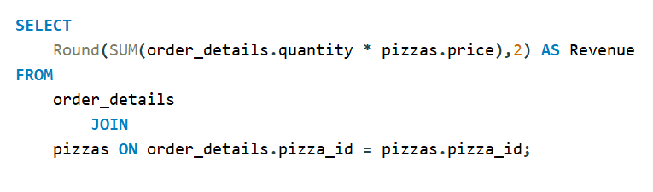
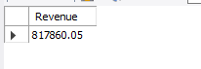

-- Calculate the total revenue generated from pizza sales.

Slide 3
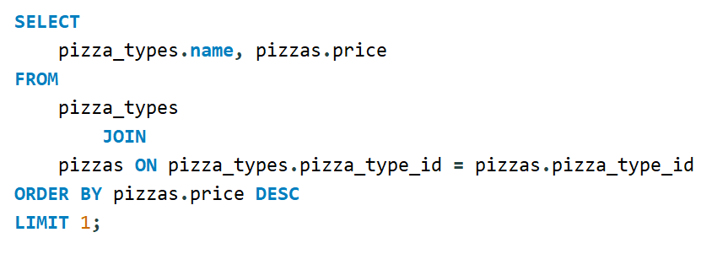
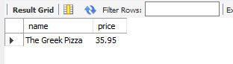
-- Identify the highest-priced pizza.

Slide 4
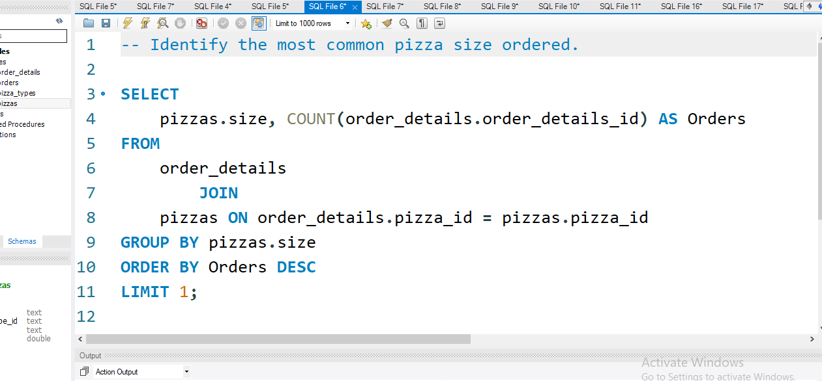
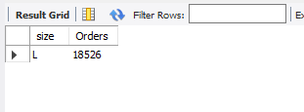
-- Identify the most common pizza size ordered.

Slide 5
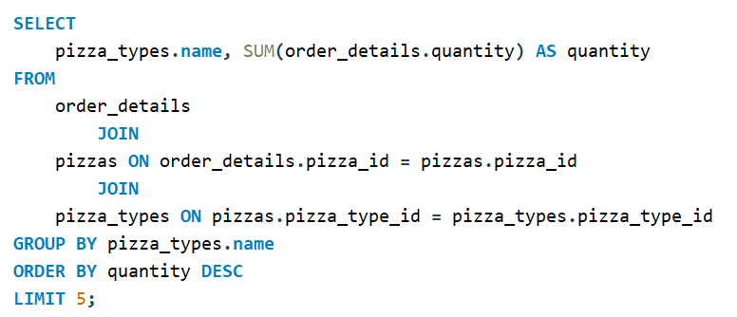
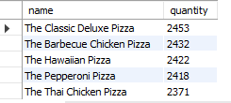
-- List the top 5 most ordered pizza types along with their quantities.

Slide 6
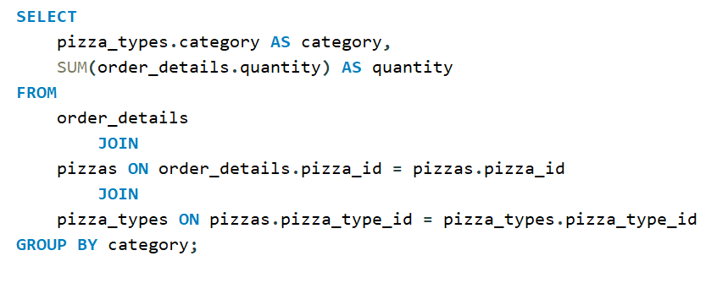
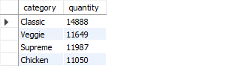
-- Join the necessary tables to find the total quantity of each pizza category ordered.

Slide 7
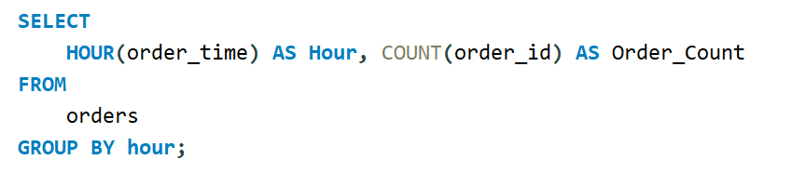
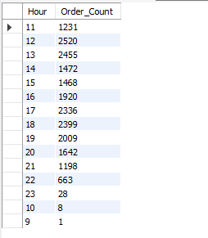
-- Determine the distribution of orders by hour of the day.

Slide 8
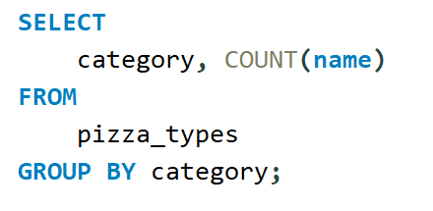
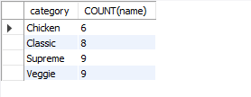
-- Join relevant tables to find the category-wise distribution of pizzas.

Slide 9
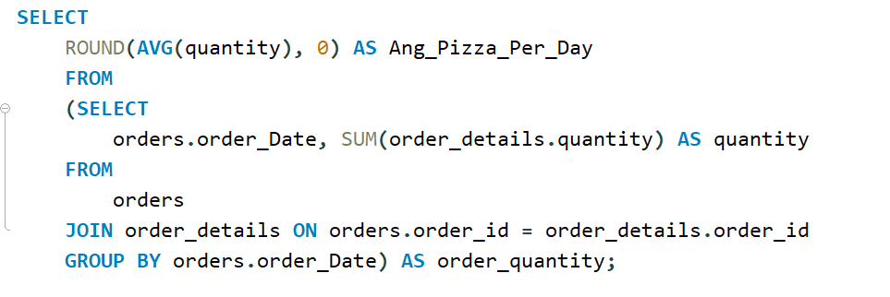
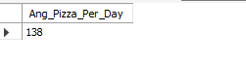
-- Group the orders by date and calculate the average number of pizzas ordered per day.

Slide 10
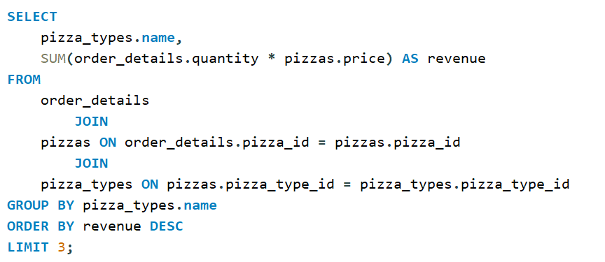
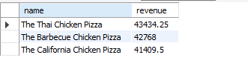
-- Determine the top 3 most ordered pizza types based on revenue.

Slide 11
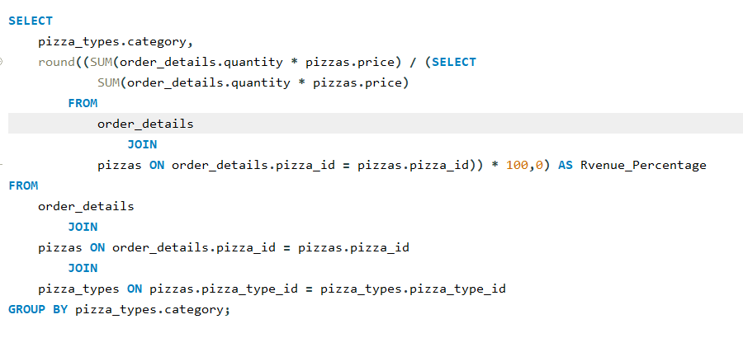
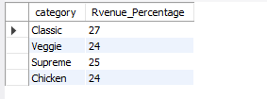
-- Calculate the percentage contribution of each pizza type to total revenue.

Slide 12
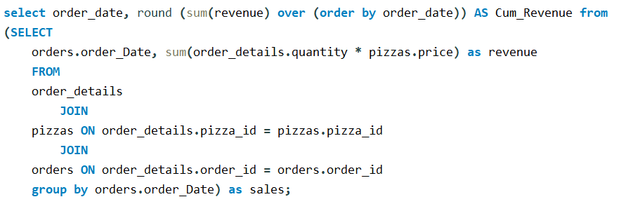
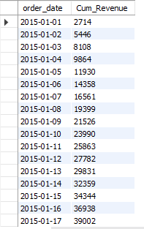
-- Analyze the cumulative revenue generated over time.

Slide 13
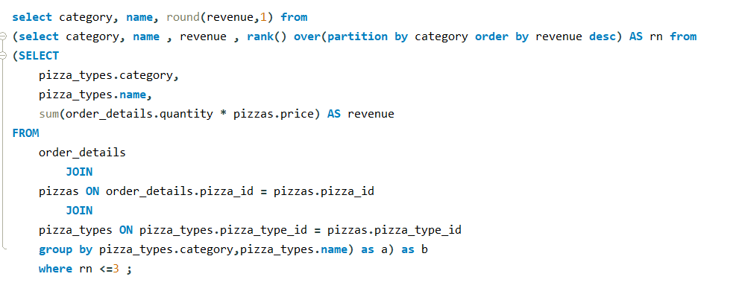
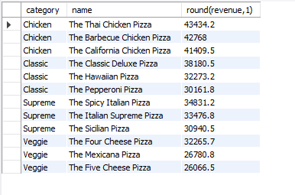
-- Determine the top 3 most ordered pizza types based on revenue for each pizza category.

Slide 14
pizza Sales
thank you!
Thank you for taking the time to review my SQL project. Please share your feedback on how I can enhance my SQL skills and learn from my mistakes.

